Slide 1
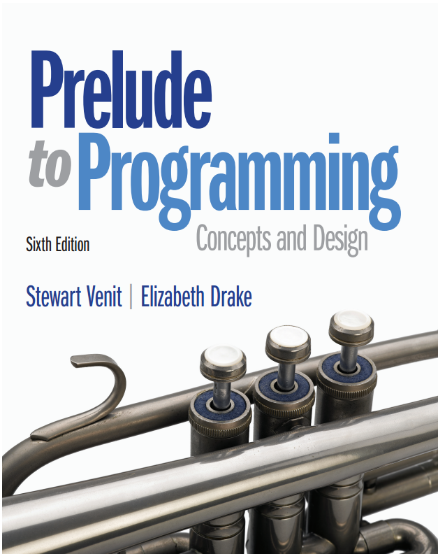
Prelude to Programming
Sixth Edition
Chapter 4
Selection Structures: Making Decisions
Copyright © 2015, 2011, 2009 Pearson Education, Inc. All Rights Reserved
Notes:
If this PowerPoint presentation contains mathematical equations, you may need to check that your computer has the following installed:
1) MathType Plugin
2) Math Player (free versions available)
3) NVDA Reader (free versions available)

Slide 2
4.1 An Introduction to Selection Structures

Slide 3
4.1 An Introduction to Selection Structures
Single-alternative (If-Then)
A single block of statements to be executed or skipped
Dual-alternative (If-Then-Else)
Two blocks of statements, one of which is to be executed, while the other one is to be skipped
Multiple-alternative (If-Then-Else-If or Case/Switch)
More than two blocks of statements, only one of which is to be executed and the rest skipped

Slide 4
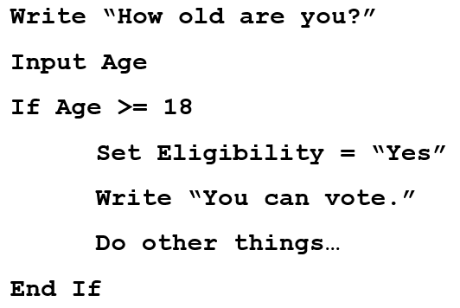
Single Alternative
If something is true Then
Do something (any
number of statements)
End If

Slide 5
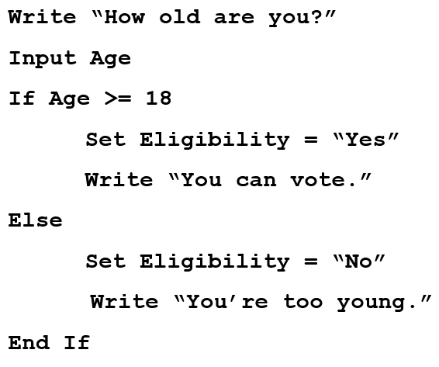
Dual Alternative
If something is true Then
Do something
Else
Do something else
End If

Slide 6
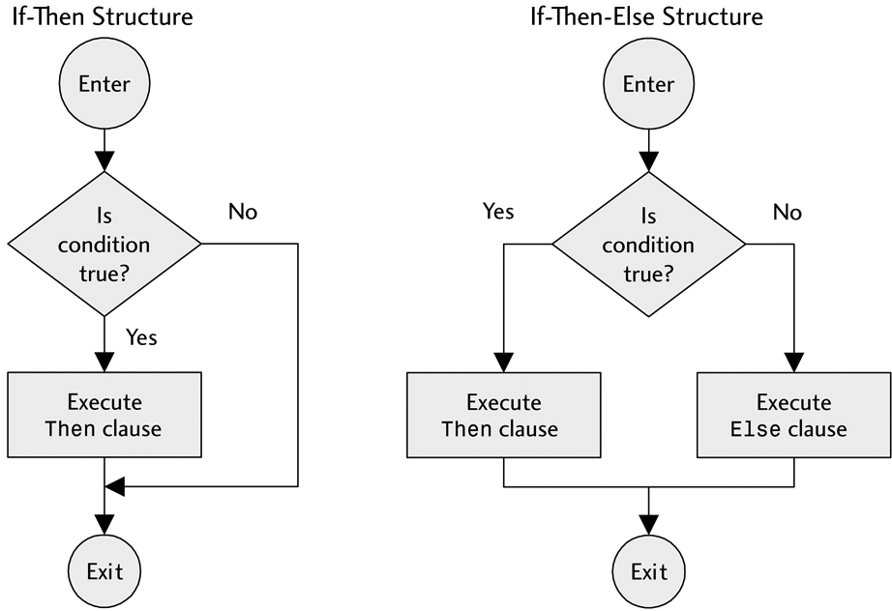
Flowcharts for Selection Structures: Single Alternative and Dual Alternatives

Slide 7
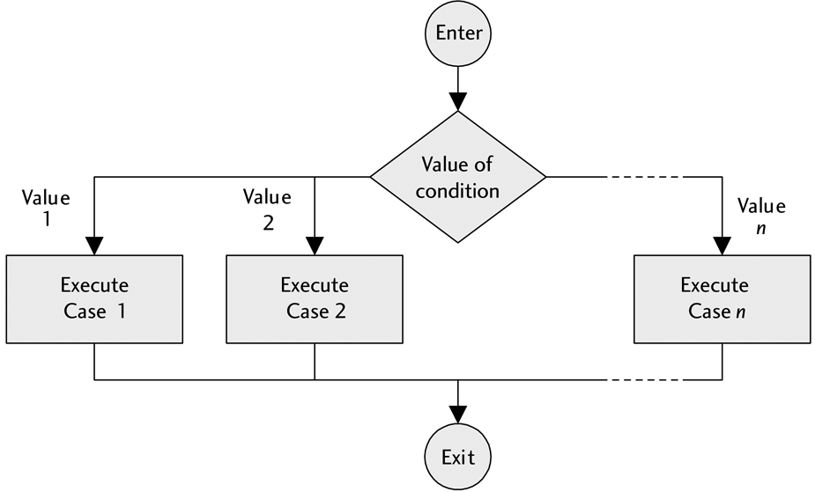
Flowcharts for Selection Structures: Multiple Alternative

Slide 8
Guidelines
An Else condition does not have to exist. Sometimes we only want to do something if something is true and do nothing if it is not true.
Do not manufacture alternative conditions.
In an If statement, the body of the If is executed if, and only if, the test condition is true. Otherwise, no action is taken.
Be sure to indent for readability.

Slide 9
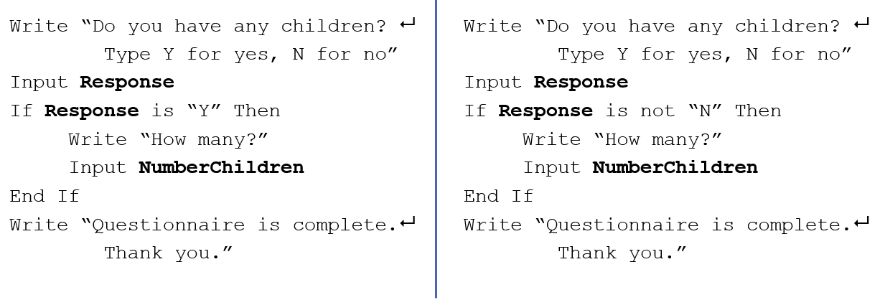
Example: two ways to write a test condition

Slide 10
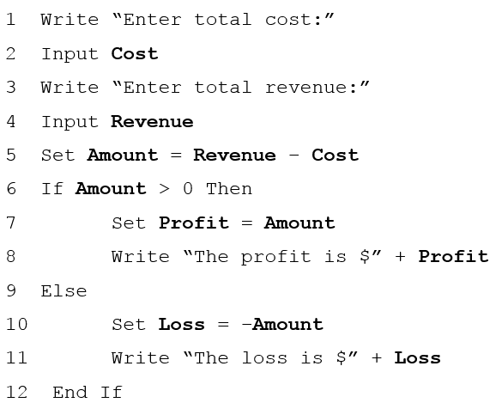
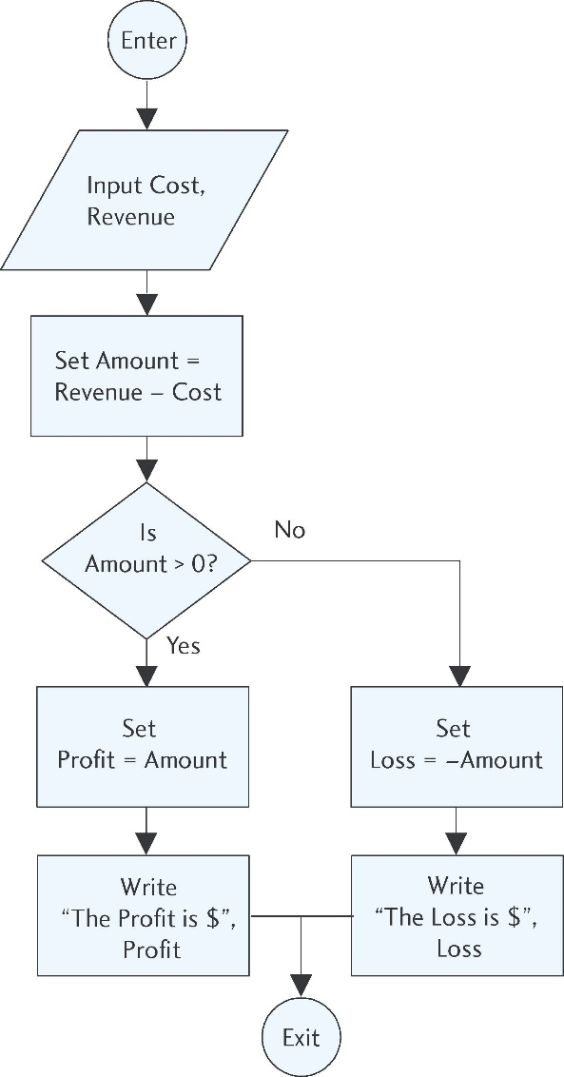
Example: Multiple Alternatives

Slide 11
4.2 Relational and Logical Operators

Slide 12
4.2 Relational and Logical Operators
Decision making involves testing a condition
To help construct these conditions use
relational operators
logical operators

Slide 13
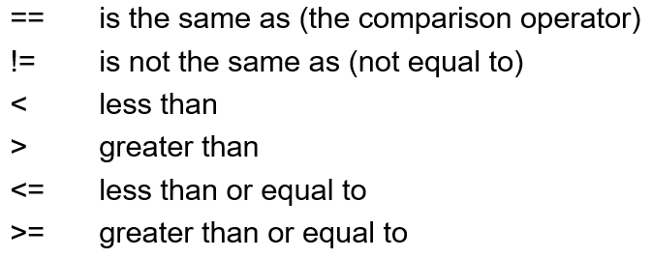
Relational Operators
Relational operators are the symbols used in the condition to be evaluated in If statements:

Slide 14
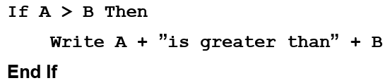

Example (1 of 2)
Assume the variables A and B have the values:
A = 9, B = 6
Then the If statement:
can be read:
“If it is true that the value of the variable A is greater than the value of the variable B, then write the value of B to the screen.”
The display will be:

Slide 15
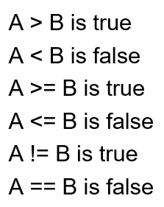
More examples:
Given: A = 23, B = 16
Then:

Slide 16
Comparison versus Assignment Operators
There is a significant difference between the use of an equals sign (=) as the assignment operator and a double equals sign (==) as the comparison operator.
As an assignment operator, the equals sign sets the value of an expression on the right side to the variable on the left side.
As a comparison operator, the double equals sign asks the question, “Is the value of the variable on the left side the same as the value of the expression, number, or variable on the right side?”
a single equals sign (=) signifies the assignment operator
a double equals sign (==) signifies the comparison operator

Slide 17
The Assignment Operator
Given: A = 14, B = 27
In programming code, the assignment statement:
A = B
sets the value of B to the variable A.
In other words, after this statement is executed, both A = 27 and B = 27.
In this case, the equals sign is used as an assignment operator.

Slide 18
The Comparison Operator
Given: A = 14, B = 27
Using relational operators, the statement:
A == B
is a comparison.
This statement asks the question, “Is the value of A the same as the value of B?” In this case, since A and B have different values, the answer is “no” and the statement would result in a value of False.

Slide 19
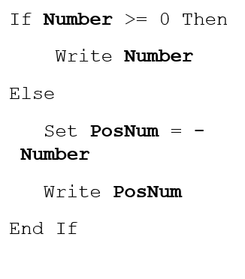
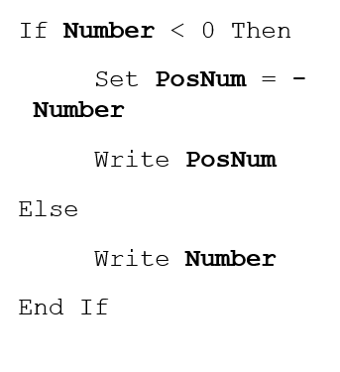
Two ways to obtain a positive result

Slide 20
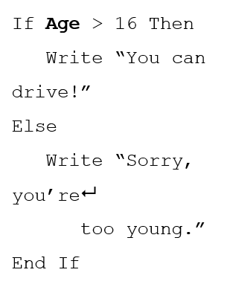
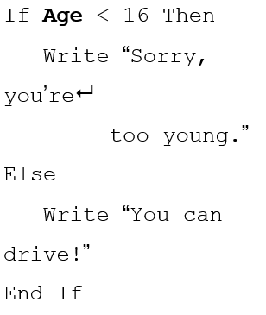
Be careful! Do these two give the same result?

Slide 21
Logical Operators
Logical operators are used to connect simple conditions into a more complex condition called a compound condition.
The simple conditions each contain one relational operator.
Using compound conditions reduces the amount of code that must be written.
Three logical operators we will use: A N D, O R, N O T

Slide 22
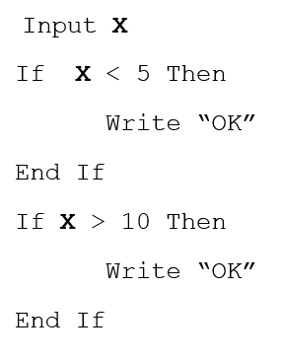
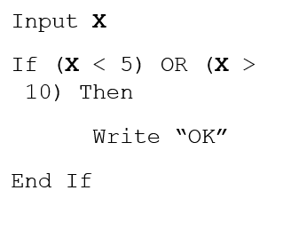
Logical operators can save space: The following are equivalent

Slide 23
The AND Operator
A compound condition consisting of two simple conditions joined by an AND is true only if both simple conditions are true.
It is false if even one of the conditions is false.
The statement:
If (X > 5) AND (X < 10) Then …
is true only if X is 6, 7, 8, or 9. It has to be both greater than 5 and less than 10 at the same time.

Slide 24
The OR Operator
A compound condition consisting of two simple conditions joined by an OR is true if even one of the simple conditions is true.
It is false only if both are false.
For example:
If (Response ==“Y”) OR (Response ==“y”) Then …
This is true if Response is uppercase (‘Y’) or lowercase (‘y’). For the above condition to be false, Response would have to be something other than either ‘Y’ or ‘y’.

Slide 25
The NOT Operator
AND and OR affect 2 simple conditions.
NOT affects only one condition. If you need to negate more than one simple condition, you will need more than one NOT.
A condition with the NOT operator is true only if the condition is false.
NOT(A < B)
is true only if B is greater than or equal to A.
If (X > 100) AND NOT(X == Y) Then…
is true only if X is greater than 100 but not equal to the value of Y.

Slide 26
Truth Tables for OR, AND, and NOT Operators
X | Y | X or y | X and y | Not x
True | True | True | True | False
True | False | True | False | False
False | True | True | False | True
False | False | False | False | True

Slide 27
Hints (1 of 2)
In a compound condition, it is necessary to use complete simple conditions.
This is correct:
If (X < 5) OR (X > 10) Then …
This is not correct:
If (X < 5 OR > 10) Then …

Slide 28
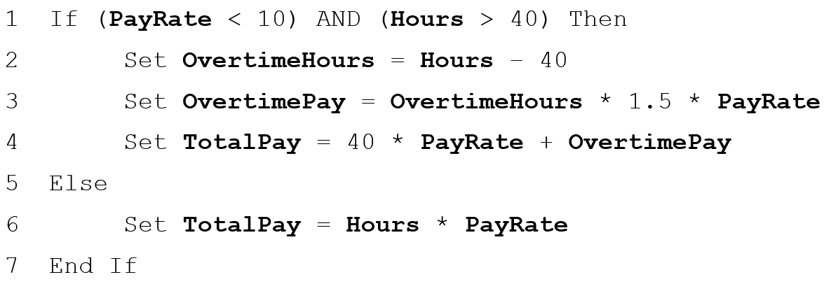
Example: First way using AND
Workers who earn less than $10 per hour are paid 1.5 times their normal rate for overtime hours. Workers who earn $10 or more per hour are paid their regular hourly rate regardless of number hours worked. Working more than 40 hours per week is considered overtime.

Slide 29
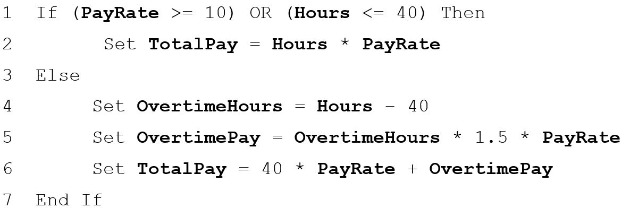
Example: Second way using OR
Workers who earn less than $10 per hour are paid 1.5 times their normal rate for overtime hours. Workers who earn $10 or more per hour are paid their regular hourly rate regardless of number hours worked. Working more than 40 hours per week is considered overtime.

Slide 30
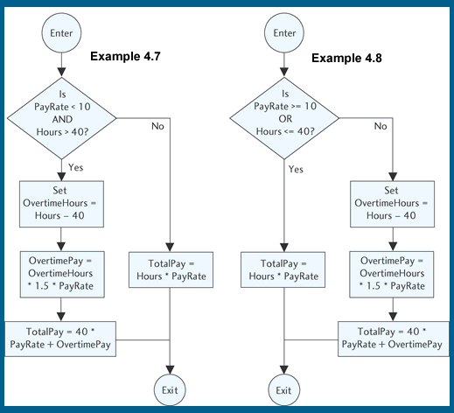
Flowcharts for the two ways:

Slide 31
Hierarchy of Operations (Order of Precedence)
Description | Symbol
Arithmetic Operators are evaluated first in the order listed | blank
First: Parentheses | ()
Second: Exponents | ^
Third: Multiplication/ Division/ Modules | *, /, %
Fourth: Addition/ Subtraction | + −
Relational Operators are evaluated second and all relational operators have the same precedence | blank
Less then | <
Less then or equal to | <=
Greater than | >
Greater than or equal to | >=
The same as, equal to | ==
Not the same as | !=
Logical Operators are evaluated last in the order listed | blank
First: NOT | ! or NOT or not
Second: AND | && or AND or and
Third: OR | || or OR or or

Slide 32
Combining Logical and Relational Operators
Example:
Let Q = 3 and let R = 5
Is the following expression true or false?
NOT Q > 3 OR R < 3 AND Q – R <= 0
Step 1: (NOT(false)) OR (false AND true)
Step 2: true OR (false AND true)
Step 3: true OR false
Step 4: true

Slide 33
The Boolean Type
Most programming languages allow variables to be of logical (or Boolean) type.
A Boolean variable may only be either true or false.
Example: Can declare a variable, Answer, to be of Boolean type and use it in a statement anywhere that a value of true or false is valid, such as the following C++ snippet:
bool Answer;
Answer = true;
if(Answer) cout << “Congratulations!”;
This means: If the value of Answer is true, then write “Congratulations!” to the screen.
The following C++ statement is equivalent to the if statement shown above and may be clearer:
if (Answer == “true”) cout << “Congratulations!”;

Slide 34
4.3 ASCII Code and Comparing Strings

Slide 35
4.3 ASCII Code and Comparing Strings
A character can be defined as any symbol that can be typed on the keyboard.
These symbols include special characters like asterisks (*), ampersands (&), @ signs, as well as letters, digits, punctuation marks, and blank spaces.
There is a more precise definition of a character using how characters are represented in a computer’s memory.
Relational operators <, <=, >, !=,==, and >= can be applied to any string of characters.

Slide 36
ASCII Code
A programming language uses a scheme to associate each character with a number.
The standard is the American Standard Code for Information Interchange (A S C I I code).
All data, including characters, are stored in the computer’s memory in binary form.
It is pronounced “askey.”
Each character is associated with a number from 0 to 127.
Examples:
Uppercase A is 65
Uppercase Z is 90
Digits have codes from 48 (“0”) to 57 (“9”)

Slide 37
Ordering Arbitrary Strings
Letters are in alphabetical order.
All uppercase letters precede all lowercase letters.
Digits (viewed as characters) retain their natural order.
For example, “1” < “2”, “2” < “3”
The blank precedes all digits and letters.
Examples: All of the following conditions are true:
“a” > “B”
“1” <= “5”
“2” >= “2”

Slide 38
Rules for Ordering Strings (1 of 2)
Two strings, S1 and S2, are equal (S1 == S2) if they have exactly the same characters in exactly the same order; they are not equal (S1 != S2) otherwise. To see which of two unequal strings comes first, use the following procedure:
Scan strings from left to right, stopping at the first position for which the corresponding characters differ or when one of the strings ends.
If two corresponding characters differ before either string ends, the ordering of these characters determines the ordering of the given strings.
If one string ends before any pair of corresponding characters differ, then the shorter string precedes the longer one.

Slide 39
Rules for Ordering Strings (2 of 2)
When applying this procedure, the following is true:
If string S1 precedes string S2, then S1 < S2.
If string S1 follows string S2, then S1 > S2.

Slide 40

Beware of Strings of Digits
A character string may be numbers like “123”. But “123” is not the same as 123.
The numeric constant is stored in memory by storing the binary equivalent of 123, but the string constant is stored in memory by successively storing the ASCII codes for “1”, “2”, and “3”.
There is no mechanism to compare numbers with strings so, if the variable (Num) is a numeric variable, statements like the following:
Num == “123”
make no sense, and will lead to an error message if used in a program.
Also, using the procedure given for ordering strings, we see that:
are both true statements!

Slide 41
4.4 Selecting from Several Alternatives

Slide 42
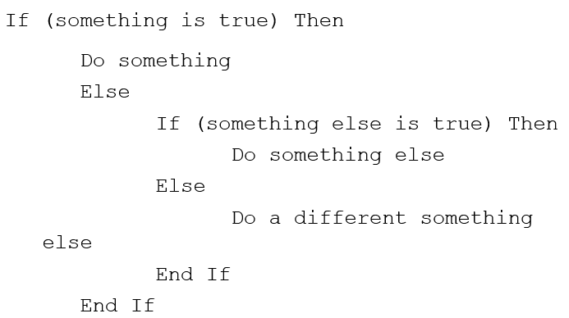
4.4 Selecting from Several Alternatives
To handle more than two options in a program we use multiple If-Then statements or multiple If-Then-Else statements.

Slide 43
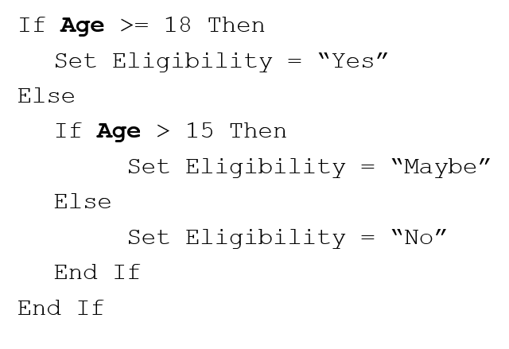
Example (2 of 2)

Slide 44
Hints (2 of 2)
The number of End If’s must equal the number of If’s.
You can draw a line to connect them to check.
In the previous example, the check for Age >15 will never be done if the Age is >= 18.
Regardless of how many possible conditions are included, only one will ever be executed.

Slide 45
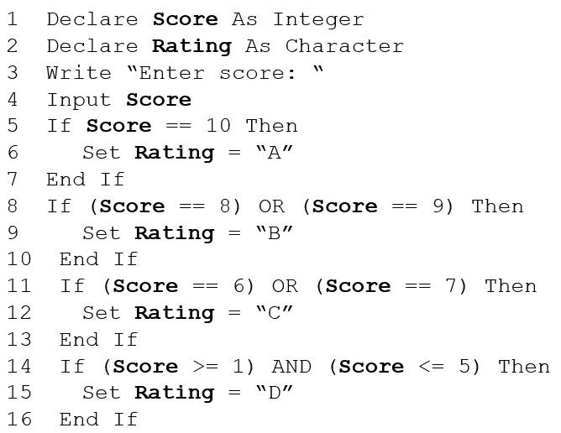
Assigning Ratings the Long Way (1 of 2)

Slide 46
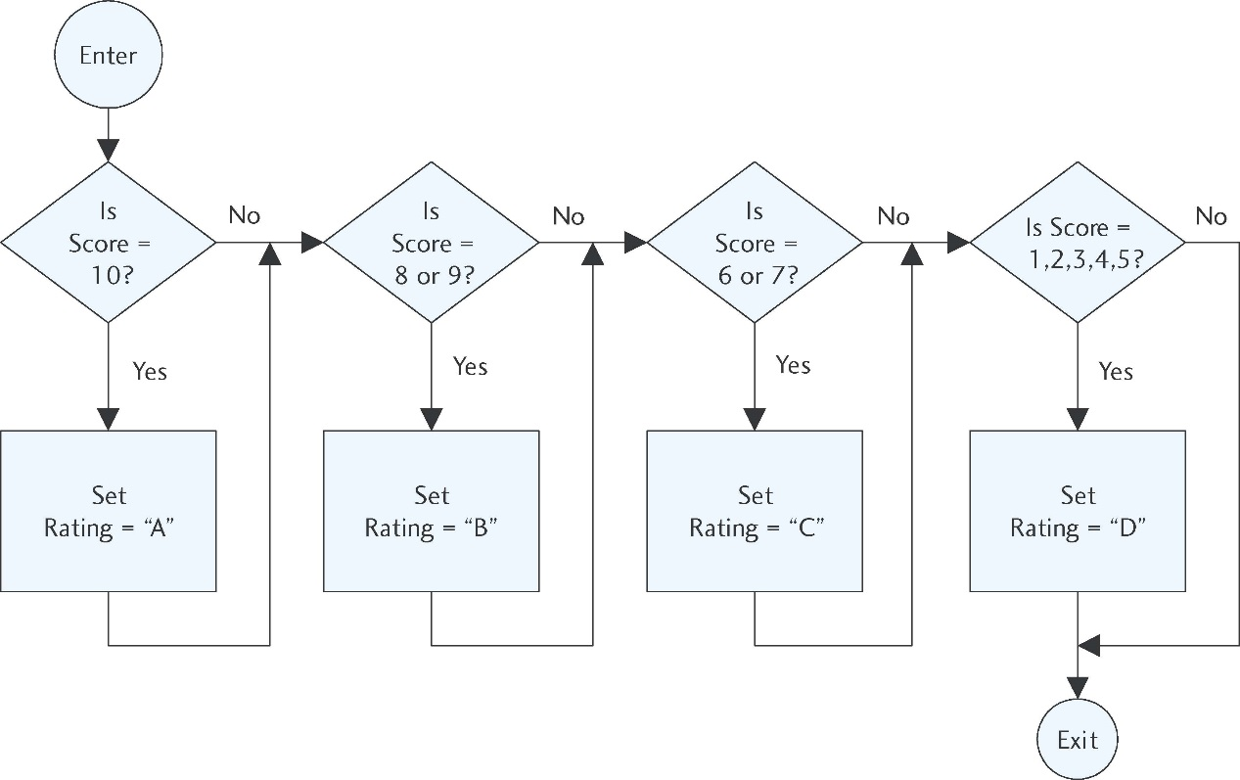
Assigning Ratings the Long Way (2 of 2)

Slide 47
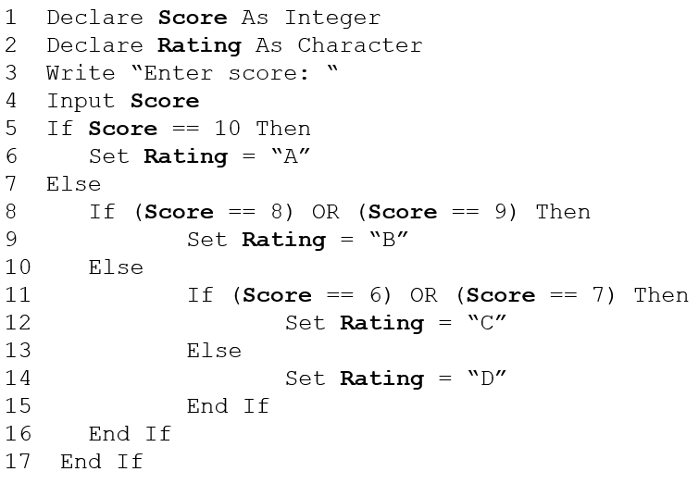
Assigning Ratings the Nested If-Then-Else Way (1 of 2)

Slide 48
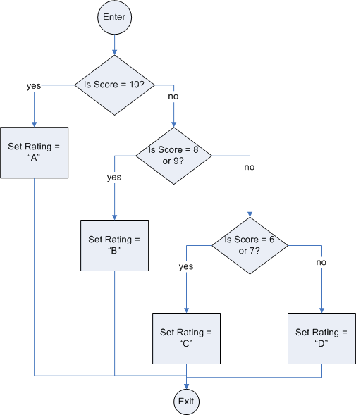
Assigning Ratings the Nested If-Then-Else Way (2 of 2)

Slide 49
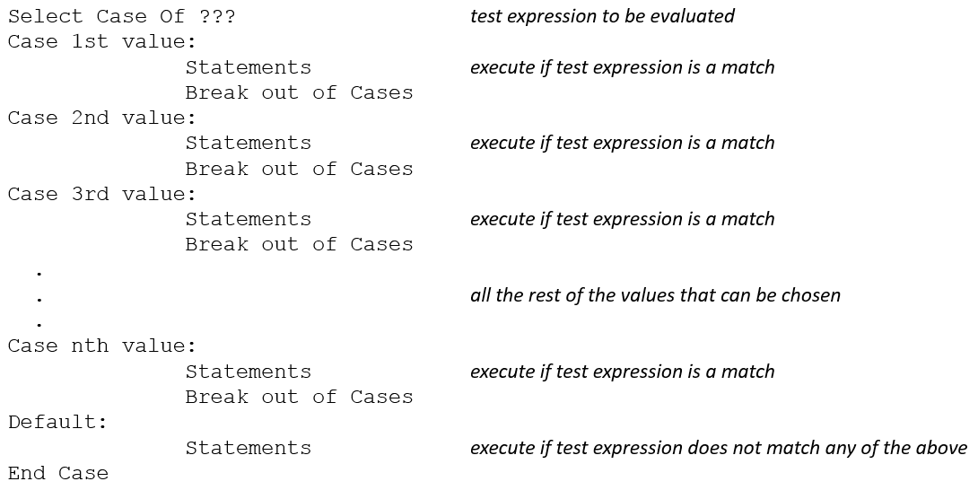
Using Case-Like (or Switch) Statements

Slide 50
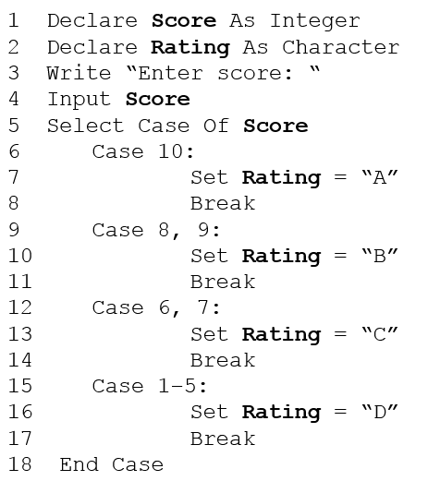
Assigning Ratings Using a Case Statement (1 of 2)

Slide 51
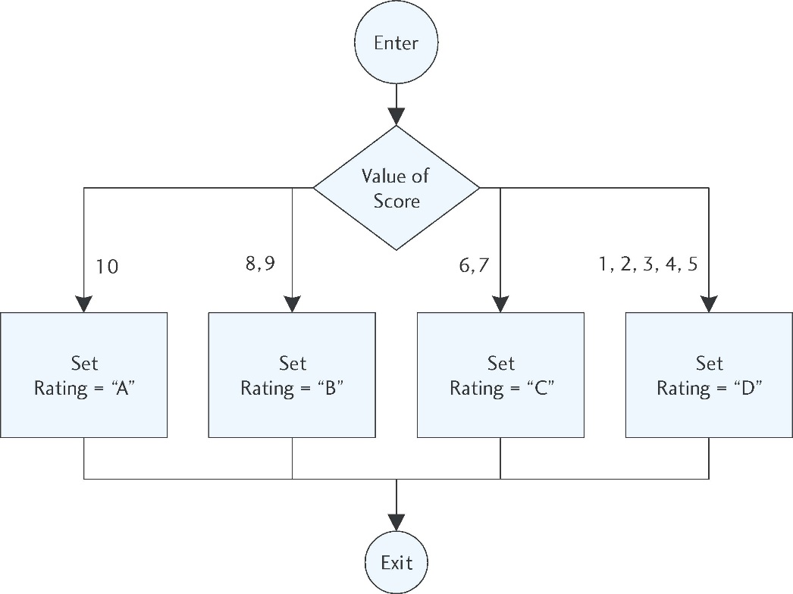
Assigning Ratings using A Case Statement (2 of 2)

Slide 52
4.5 Applications of Selection Structures

Slide 53
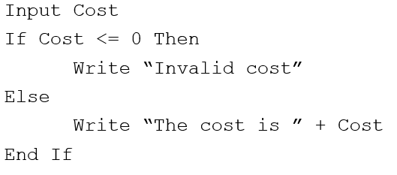
4.5 Applications of Selection Structures
Defensive Programming:
Program defensively in order to prevent bad data from entering our program. To do this, set error traps.
If our program should accept only a Cost greater than 0, we can stop any other value from entering with the following trap:

Slide 54
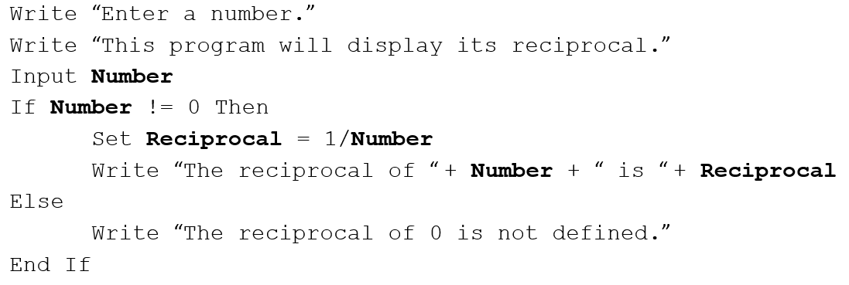
Error Trap for a Division by Zero Error
The reciprocal of a number is 1 divided by that number. But division by zero is not allowed ao the reciprocal of 0 is undefined. The following example will display the reciprocal of any number:

Slide 55
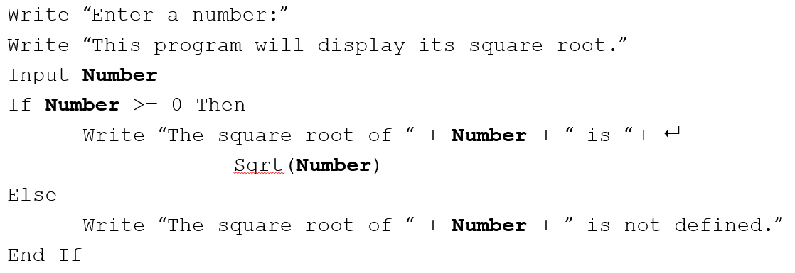
Avoiding Illegal Operations: the Sqrt() function
The following program segment displays the square root of a number unless the number is negative:

Slide 56
Defensive Programming
Be sure to test your program by “playing computer.”
This is also called “desk checking.”
Perform all calculations multiple times manually or with a calculator.
Use data that will show the results when each branch of each selection structure is executed at least once.
Check for division by zero, negative values for a square root function, and any other special conditions.

Slide 57
Menu-Driven Programs
A major goal of a programmer is to create user friendly programs.
When the user has many options, menus are often used.
Such programs are menu-driven.
Menus are usually arranged in a row near the top of the screen.
The user clicks the mouse on the desired choice.
The main menu (a list of the program’s major functions) is usually the first thing the user sees.

Slide 58
Sample Menu
The Legendary Lawn Mower Company Inventory Control
Leave the program ...................Enter 0
Add an item to the list .............. Enter 1
Delete an item from the list ...... Enter 2
Change an item on the list ........Enter 3

Slide 59

Copyright

